Slide 1
Project Work :
UE15CS492(Minor)
Final ISA(Review 5)
Project Title :Detection of Events and Emerging Themes from Social Media Streams
Project ID :PW19COP01
Project Guide :Mr. C. O. Prakash
Project Team :Vaishnavi Rao (USN: 01FB15ECS334)
Varsha R. (USN: 01FB15ECS337)
Team Name :PES_334_337_000

Slide 2
Problem Statement
The problem:
News articles, social media posts and tweets are always haphazard and uncategorized.
There's no categorization of each tweet into certain trending topics.
This often has users encountering a lot of tweets not relevant to their topic of interest

Slide 3
Users can often learn about trending and emerging events via displayed topics that are being discussed amongst tweeple on the internet
Detecting events and trending topics from these hashtags in a way so as to make a user’s feed more enriching and optimal is the primary goal of this project.
A holistic comparison of the different methods in which to detect these events and trending topics is also included in the ambit of this project.

Slide 4
User Profile
Distinct users who are facing this problem:
Twitter users
Facebook users
Instagram users
InShorts users
Other online news and article platforms

Slide 5
Literature Survey
Catching the Long-Tail: Extracting Local News Events from Twitter [1]
To detect the messages that report occurrence of an event, they have used a two step process. In the first step they reject tweets that follow a specific pattern using regular expressions, and the second step is supervised classification and boosting.
For detection of relevant tweets, the approach using supervised classification of individual tweets is able to catch the sparsely reported events in the ‘long-tail’.
Improvised standard NLP techniques are also used so that they work on the informal language often used in Twitter.

Slide 6
Literature Survey
Topic Extraction from News Archive Using TF*PDF Algorithm [2]
Uses the novel TF*PDF algorithm to recognize the terms that try to explain the main topics. These would be the terms that appear frequently in many documents from many newswire sources concurrently. TF*PDF algorithm is designed in a way that it would assign heavy term weight to these kind of terms and thus reveal the main topics. TF*PDF algorithm performs well in extracting the terms explaining the main topics, by taking advantage on the concept that whenever there is a hot topic on air, the terms that explain the hot topics will appear frequently in many documents from multiple newswire sources.

Slide 7
Literature Survey
A SURVEY OF TECHNIQUES FOR EVENT DETECTION IN TWITTER [3]
This paper discusses event detection techniques unique to Twitter data and classifies it according to event type, detection task, and detection method. It also includes a brief description of event detection as applicable to traditional media outlets in which some of them have been adapted to suit Twitter data. This is further classified into detection based on document or temporal features. For Twitter data specifically, unsupervised and supervised detection approaches have been elaborated upon, along with an explanation of sub-classification based on event type and detection methods.

Slide 8
Literature Survey
Sentiment-Based Event Detection in Twitter [4]
This article aims to determine whether sentiment analysis can be used as a method to detect significant events occurring around the world.
Most methods for event detection concentrate solely on the increasing frequency of terms used in social media in event detection.
The results, the paper observes, tell us that sentiment-based solutions produce comparable performance with frequency-based approaches and are more effective in detecting them within a 1-day period.

Slide 9
Literature Survey
Tweet Analysis for Real-Time Event Detection and Earthquake Reporting System Development [5]
This paper attempts to do an analysis/monitoring of tweets in order to be able to detect earthquakes in real time.
The approach taken is one of the classification of tweets by putting them through a Naive Bayes classifier, based on features as keywords, sentiment, number of words, and context. Post this classification, a probabilistic value is associated with the tweets under consideration which signifies the occurrence or non-occurrence of the earthquake.
The study hopes to further the results obtained to create an application to alert users of the disaster based on their geo-location.

Slide 10
Proposed Solution
We intend to build a model that generates the trending topics of the day after being fed the tweets of the day.
We want to figure out the best algorithm to use by testing it on various machine learning and data science models and comparing accuracies (eg:- naive bayes, ANN, Random Forest, Logistic regression, etc)
We want to use an available Twitter dataset for training but test it on actual tweets scraped from twitter.com

Slide 11
Why Your Solution is Better?
The solution proposed aims at a far-reaching collection and display of events detected in the news in a way that makes an everyday user’s feed more comprehensive.
Will adhere to customization of tweets displayed on the feed based on the trending topics
The existence of an optimal methodology for extracting the events allows one to have a more personalised, efficient, and up-to-date feed that can be utilised during analyses.
We will adhere to the importance of the trending topic and focus on topics by selecting only relevant categories. Eg: Earthquake warning will be trending over a celebrity wedding.

Slide 12
Technologies / Methodologies
List of technologies to be used:
We will use Python to build the model, train and test the data. Jupyter notebook will be our platform. We will then use simple front end like HTML, CSS, JavaScript (ReactJS)to display and present our outputs.
We will be following the Agile Methodology in the implementation of this project.
Agile has been chosen for its flexibility, in terms of accommodating changes with less overhead on the entire process, as well as for the continuous development and iteration approach that a project of a dynamic nature as this requires.

Slide 13
Dependencies and Risks
Dependencies:
The project will depend on the efficient functioning of Twitter minus any crashes on any given day to be able to conduct real time analysis smoothly in the long run.
A proper, working internet connection that keeps the end user connected with their surroundings in order to access Twitter easily.
Risks:
Misinformation given by people is the biggest threat that the project faces.
Additionally, false positives generated by the model can pose a problem that will cause confusion among the users.
Assumptions:
Each Twitter user is assumed to be a sensor, that detects a target event and makes an observation. This observation is the actual tweet.
The tweets are given time values as well as a location (latitudinal and longitudinal coordinates).

Slide 14
System Architecture
We plan to follow the MVC system architecture
Model: we will have a business unit with basically our fixed twitter training data. The twitter live data fetched from the website will be our testing data, both stored in our database.
View: we do require a front end view to display to the users. Although there isn’t much interaction with the interface, it is required to hide the implementation from the end user and for simple display of resultant tweets
Controller: since we have number of algorithms that are being tested on the tweets, a voting mechanism is adopted at the backend and the best algorithm is chosen to display the outputs to the user interface.

Slide 15
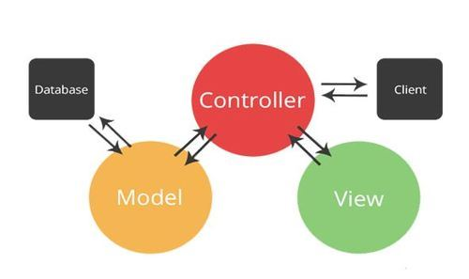
System Architecture

Slide 16
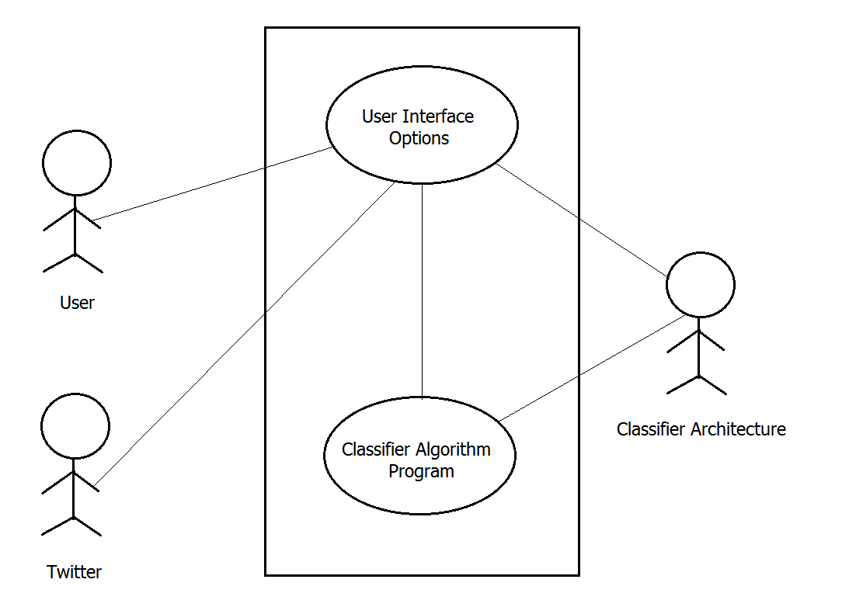
UI/ Use Case
Provide use case diagrams /User Interface diagrams

Slide 17
Modules
Tweets trending currently is sent as input to the model
on clicking on the trending topic, most relevant tweets with respect to natural disasters, health hazards (epidemic and breakouts), terror attacks and severe weather forecasts will be displayed. These will be the only 4 categories.
If no relevant trending tweets were found that belong to any of these categories, the tweets will be displayed as usual (label 0)

Slide 18
Modules
Preprocessing
Vectorization
ModelTraining
ModelTesting
EvaluationMetrics
Item Manager
Database
User
Trending tweets

Slide 19
For Example,
Design Approach
The design approach used in the project is a mix of both top-down and bottom-up, which, individually used, aren’t as effective as when used together.
Top-down design starts with a generalized model of system and keeps on defining the more specific part of it. When all components are composed the whole system comes into existence.
A top-down design is more suitable when the software solution needs to be designed from scratch and specific details are unknown. This approach is followed in the building of the project’s core, that is, the main model implementing the different algorithms.

Slide 20
For Example,
Design Approach
The bottom up design model starts with most specific and basic components. It proceeds with composing higher level of components by using basic or lower level components. It keeps creating higher level components until the desired system is not evolved as one single component. With each higher level, the amount of abstraction is increased.
Bottom-up strategy is more suitable when a system needs to be created from some existing system, where the basic primitives can be used in the newer system. This approach is being followed to implement the front-end and the backend of the project.

Slide 21
Design Constraints, Assumptions & Dependencies
TECHNICAL CONSTRAINTS:
Programming Language: The programming language of choice for the bulk of the project is Python, given its immense popularity in non-enterprise-related applications. It offers an easier and faster way to build high-performing algorithms, along with an extensive collection of specialized libraries available as well.
Operating Systems and Platforms Supported: The vision is to build a fully-functional project that works smoothly across platforms, and are currently implementing the project on a standard Windows and linux device.
Frameworks: The front-end (user interface) is based on a standard MVC framework.

Slide 22
Design Constraints, Assumptions & Dependencies
DEPENDENCIES:
A major portion of the project design and implementation is dependent on the availability of data in large numbers, and subsequently, necessary servers to be able to stream data without any hindrance.

Slide 23
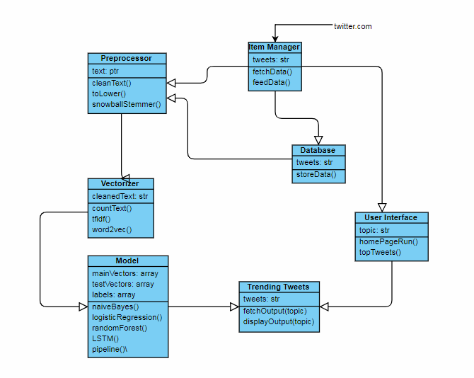
Design Description
MASTER CLASS DIAGRAM

Slide 24
Test Strategy
Unit testing:
Every single element of our project needs to be tested. For this, we first prepare a test dataset with the relevant tweets belonging to all categories 0, 1, 2, 3, 4.
We generate a label for each of these tweets using all the algorithms available.
We then display a few tweets belonging to each category. We manually analyze the tweets and finalize on the algorithm to be chosen

Slide 25
2. Integration testing
This is the phase where we need to merge both the front-end with our Python code.
We will then feed tweets whose labels we know and generate labels and compare with the actual labels. This will also help us in generating an accuracy for better understanding of how the algorithm chosen performs.
3. System Testing
There really isn’t a system testing stage as after integration, the entire system is completely built and hence becomes redundant.

Slide 26
Implementation Details
The dataset the UI displays has been fetched from Twitter.com’s latest updates and hashtags.
The dataset used for training has data from CrisisNLP.org and kaggle 1.6M dataset
We then apply the same text preprocessing function to all our data (training, testing) and an unique text vectorization for each different model
The implementation of all the 4 algorithms for training, testing are coded in Python. Based on the results obtained, fine tuned logistic regression was observed to perform the best.
We chose this model for the implementation of our product

Slide 27
Project Completion
The project is complete with respect to implementation and displaying a simple front end. We will still need to get the UI to display the different categories. It does it for label 0
The output displayed for each label can be manually verified. There are a few wrongly classified labels as the model we’re using isn’t very intelligent. Using smarter algorithms like CNNs and RNNs with LSTM will generate better results.

Slide 28
Project Results
Logistic Regression is one of the most used Machine Learning algorithms for binary classification. It is a simple Algorithm that you can use as a performance baseline, it is easy to implement and it will do well enough in many tasks.
After choosing Logistic Regression as our final model, we fine tune it using GridSearchCV and finding the best parameters. After running this model on our test data we get outputs for each label which is clearly seen in the test outputs displayed.

Slide 29
Project Results
2. Logistic regression:
With tfidf vectorization
0.9642995731470703
Confusion Matrix :
[[411 0 0 0 3]
[ 5 750 0 0 0]
[ 11 0 829 0 0]
[ 1 0 0 173 0]
[ 62 7 3 0 322]]
1. Multinomial Naive Bayes:
With count vectorization
0.9408424041646948
Confusion Matrix :
[[375 12 20 2 5]
[ 1 753 0 0 1]
[ 8 0 831 0 1]
[ 0 0 0 174 0]
[ 40 21 17 0 316]]

Slide 30
Project Results
4. Artificial Neural Networks
With Text Tokenizer
0.9657610718273167
Confusion Matrix :
[[399 0 1 1 16]
[ 3 759 1 0 10]
[ 4 0 835 0 5]
[ 4 0 0 267 2]
[ 38 2 3 2 335]]
3. Random Forest classifier
With word2vec vectorization
0.9654519640321817
Confusion Matrix :
[[407 0 1 0 6]
[ 1 753 0 0 1]
[ 4 0 834 0 2]
[ 0 0 0 174 0]
[ 40 2 0 0 352]]

Slide 31
Project Results
The results of the best model:
5. Pipeline - gridsearchCV- logistic regression
With Tfidf Tokenizer
0.9736127279782693
The best parameter set is :
{'lr__C': 10, 'tfidf__max_features': None, 'tfidf__min_df': 3, 'tfidf__ngram_range': (1, 2), 'tfidf__stop_words': None}
Confusion Matrix :
[[402 0 1 0 11]
[ 4 750 0 0 1]
[ 6 0 834 0 0]
[ 0 0 0 174 0]
[ 43 2 0 0 349]]

Slide 32
Planned Effort Vs Actual Effort
Effort | Hours/Person | Actual hours/person
Feasibility Study | 4 | 4
Literature Survey | 12 | 20
Requirement Specification | 10 | 8
High Level Design/Documentation | 15 | 10
Coding and Implementation | 100 | 77
Testing | 89 | 100
Report Writing | 20 | 25
Buffer for Risks | 6 | 6
Total | 256 | 250

Slide 33
Lessons Learnt
Tweepy module: We learned about the Python module called tweepy meant to access the Twitter API using the hashtags
We learned how simple algorithms like logistic regression can perform better compared to complex time consuming models like neural networks or random forests.
We faced a lot of challenges getting data from various sources. Terror attacks data was almost impossible to find. Only hashtag based results were available or the Tweet IDs were given.
But overall after text processing and vectorization, we realized that numbers are all we need to get predictions
We also observed how some tweets are classified wrongly because of the model generalizing certain keywords to be associated with a label without intelligence.

Slide 34
Lessons Learnt
CONCLUSION
To conclude. we aimed at building a model that analyses Twitter data (Tweets) and categorizes haphazard tweets into 4 categories: natural disasters, disease outbreaks, terror attacks and extreme weather. We believe that this news is essential and should be prioritized over other irrelevant tweets (like about a celebrity’s wedding). We achieved this by a Python backend that uses 4 algorithms- Multinomial Naive Bayes, Logistic Regression, Random Forests and Artificial Neural Networks. They train on our labeled dataset and achieved good validation results. We also had a front end that displays the data according to the option chosen by the user to display.

Slide 35
Lessons Learnt
Further Enhancements
We intend to further take this project further and convert it into a full fledged news reporting site that not only analyses data from Twitter.com but also from Facebook status updates, inshorts, etc and possibly have more categories than the 4 we have now. We could have a UI with a lot more features where the user can also tweet or comment on the tweet along with repost and like features. Social media is always evolving and having a specific site only for urgent important news display will become quickly popular among the masses.

Slide 36
Thank You

